Slide 1


UNIT 3

Slide 2
Capacitive transducer
1.variable Capacitive transducer
2. Differential Capacitive transducer

Slide 3
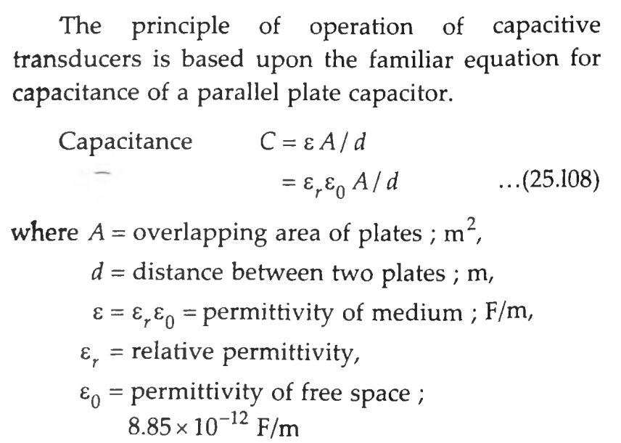
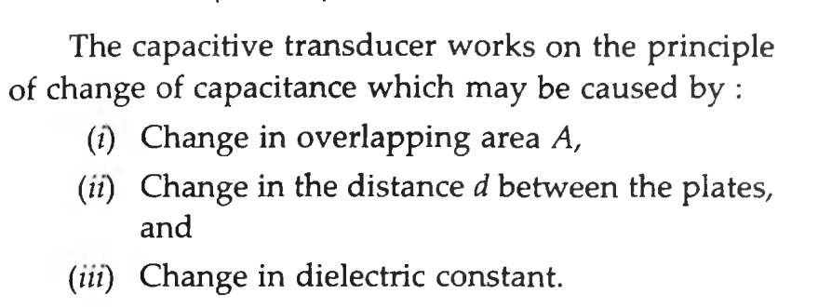
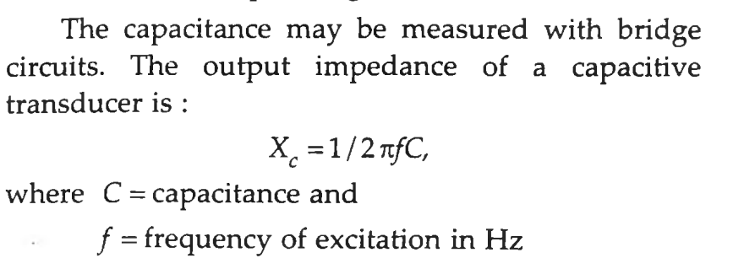
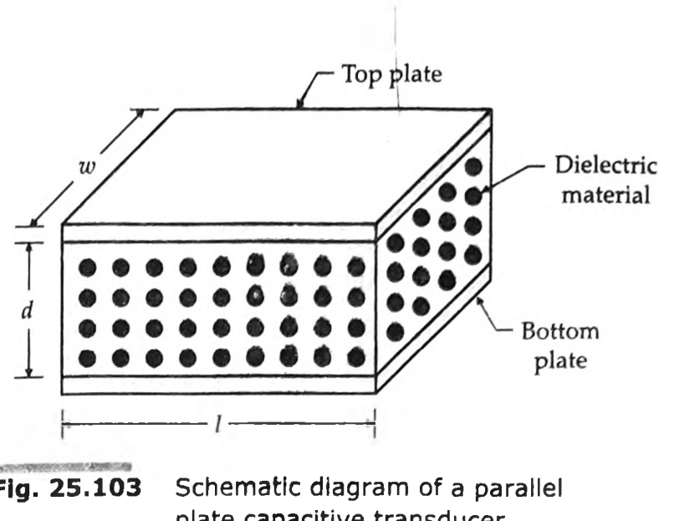
1.variable Capacitive transducer

Slide 4
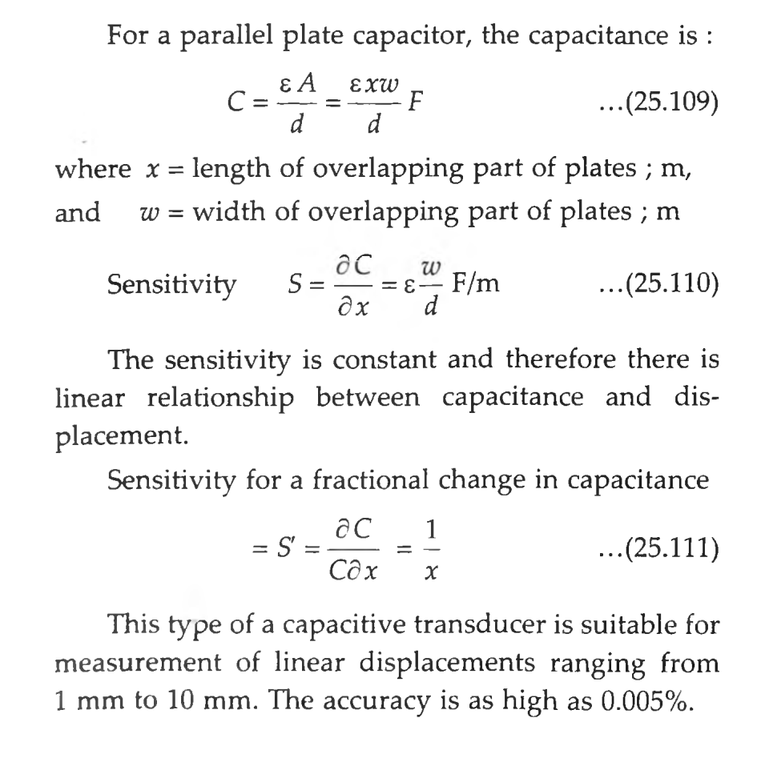
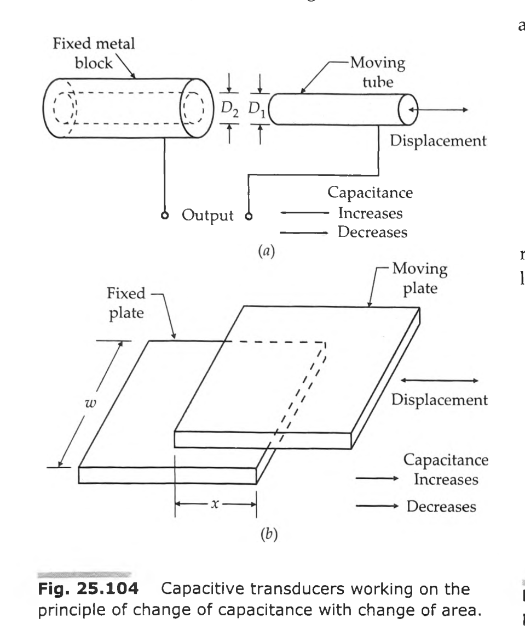
Transducers Using Change in Area of Plates
the capacitance is directly proportional to the area, A of the plates. Thus the capacitance changes linearly with change in area of plates.
Hence this type of capacitive transducer is useful for measurement of moderate to large displacements say from 1 mm to several centimetres.

Slide 5
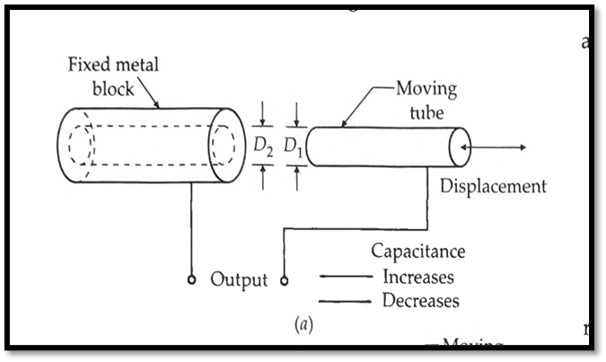
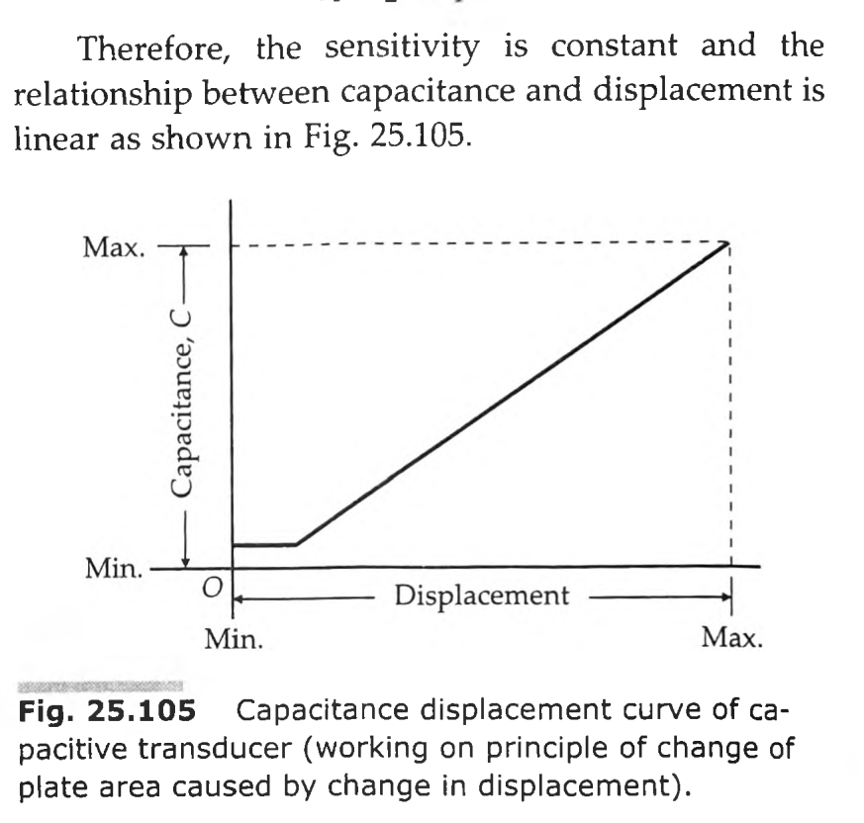
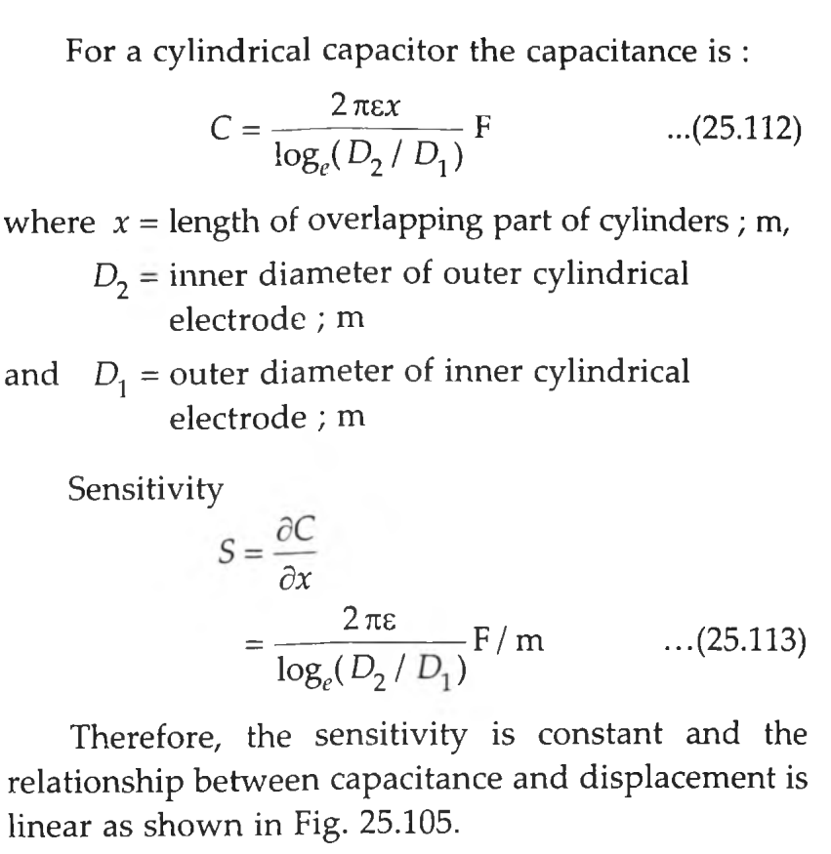

Slide 6
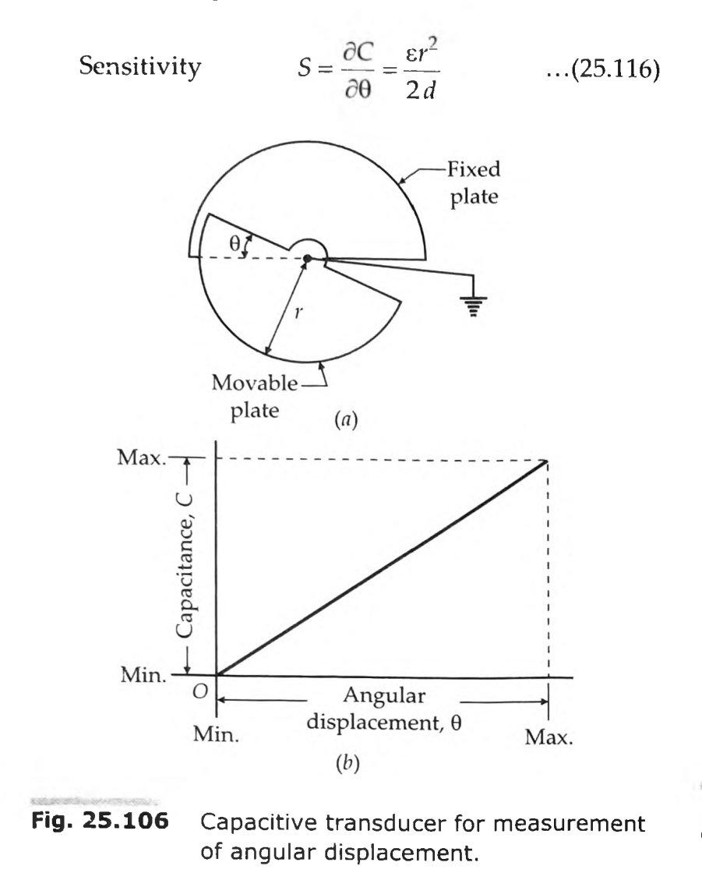
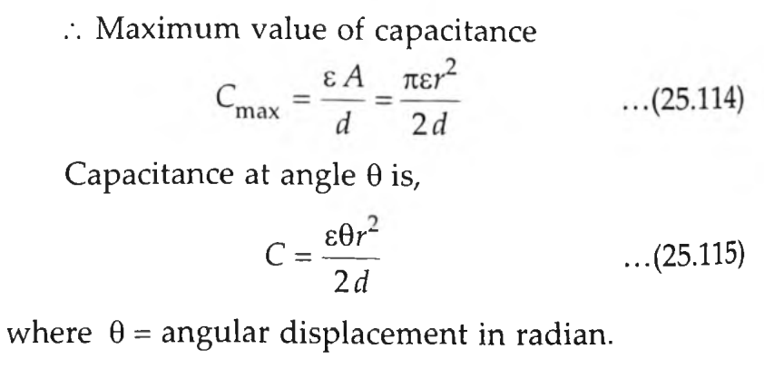
change of capacitance with change in area can be employed for measurement of angular displacement
The variation of capacitance with angular displacement is linear.
It should be understood that the above, mentioned capacitive transducer can be used for a maximum angular displacement of 180°.

Slide 7

2.Transducers Using Change in Distance between Plates
capacitive transducer utilizing the effect of change of capacitance with change in distance between the two plates.
One is a fixed plate and the displacement to be measured is applied to the other plate which is movable. Since, the capacitance, C, varies inversely as the distance d; between the plates.

Slide 8
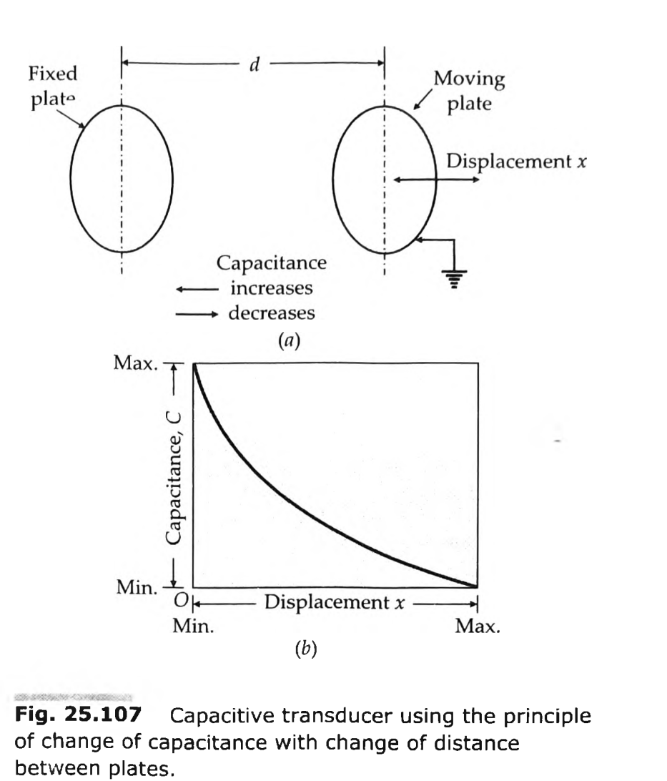
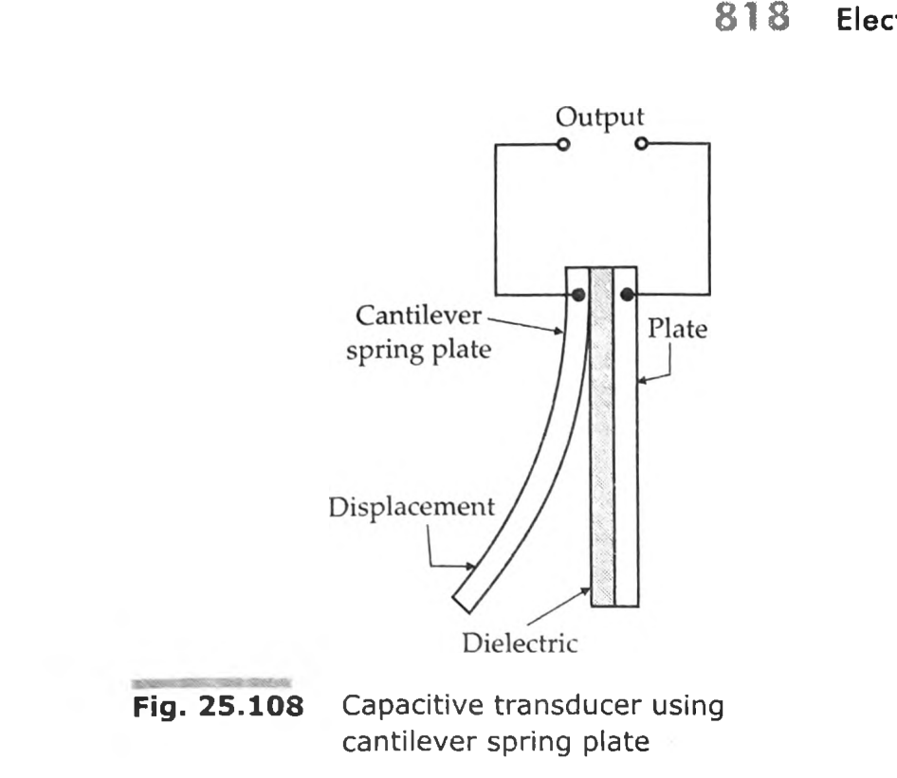
Figure shows an arrangement for measurement of linear displacement.
The displacement when applied to the cantilever type spring plate moves it towards the second plate decreasing the distance.
This increases the capacitance of the capacitor.
It is clear that the capacitance of air dielectric capacitor does not vary linearly with change in distance between the plates and therefore, this arrangement is fundamentally non-linear.

Slide 9
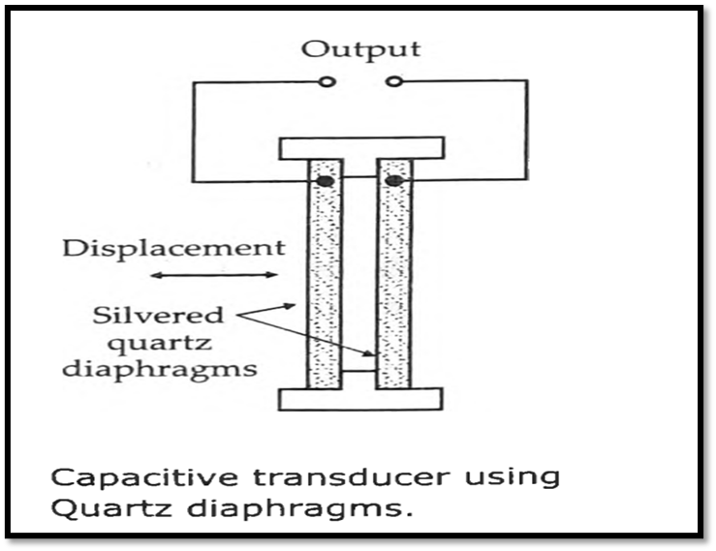
Two silvered quartz diaphragms form a capacitor as shown in Fig.
The displacement of these diaphragms varies the capacitance of this capacitive transducer.
This type of a transducer forms a pressure gauge which works very satisfactorily.
If the pressure is reduced to perfect vacuum between the diaphragms, the transducer measures the absolute pressure of the surrounding medium.
Quartz is used because it has a very low mechanical hysteresis.
The disadvantage of this type of transducer is that it has high temperature co-efficient.

Slide 10
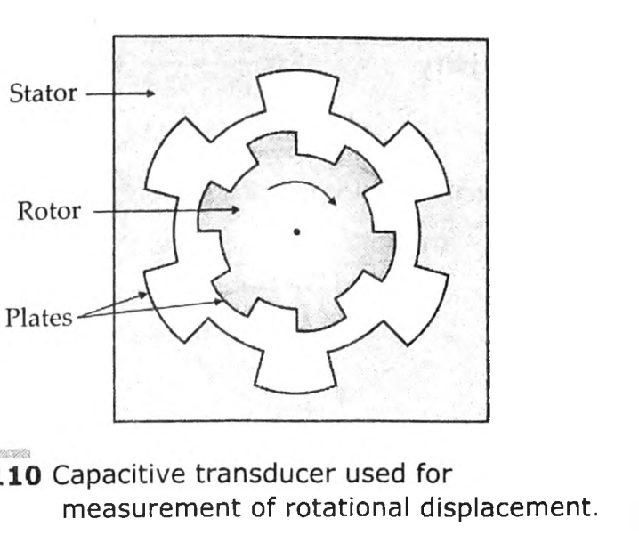
Rotational displacement can be measured with an
arrangement shown in FIG.
As the rotor plates of the capacitor are displaced in the counter clockwise direction the capacitance increases. The change in the capacitance is a measure of the angular displacement.
This capacitive transducer can be effectively used for measurement of torque.

Slide 11
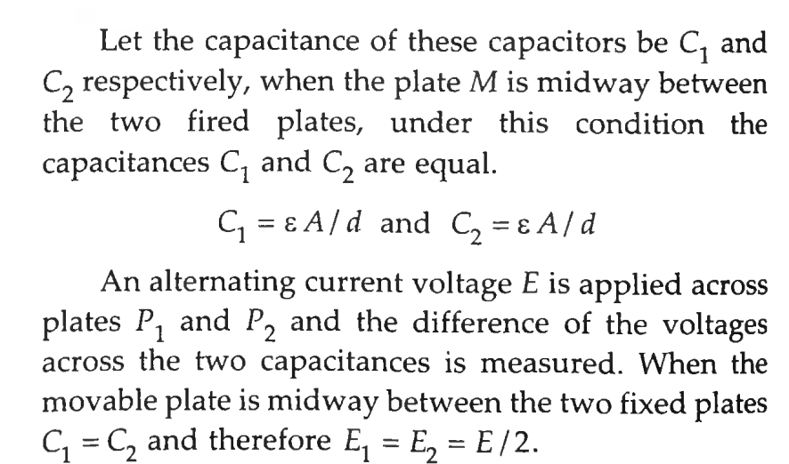
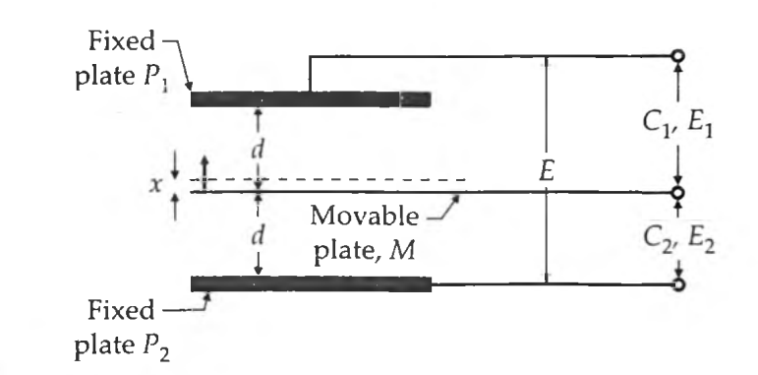
Differential Arrangement
A linear characteristic can be achieved by using a differential arrangement for the capacitive displacement transducers.
This arrangement using three plates is shown in Fig. and P2 are fixed plates and M is the movable plate to which the displacement to be measured is applied.
Thus we have two capacitors whose differential output is taken.

Slide 12
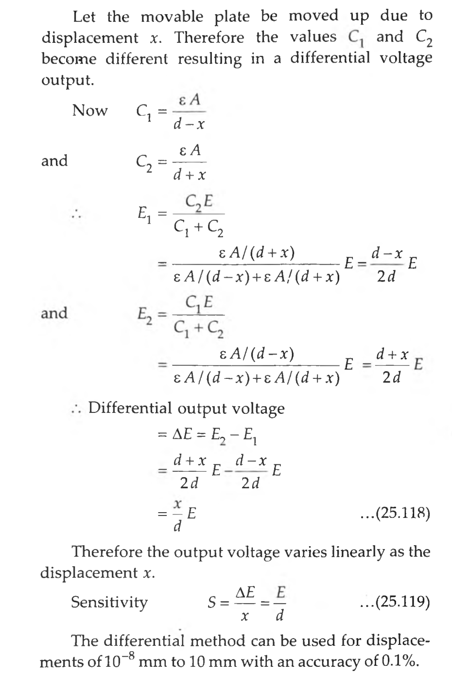
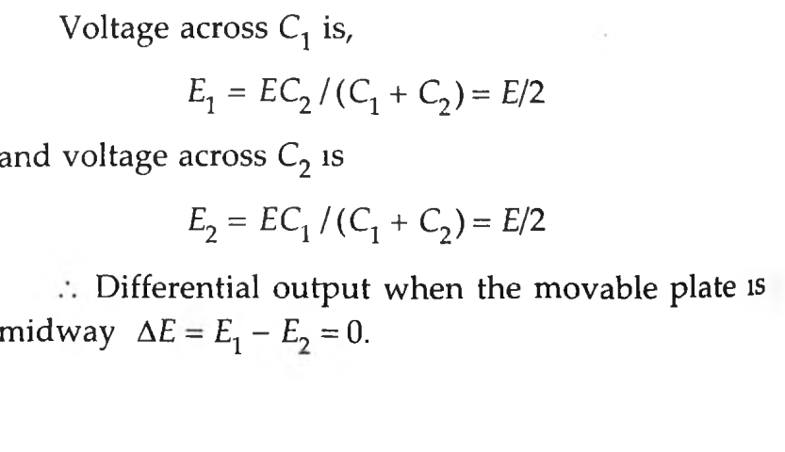

Slide 13
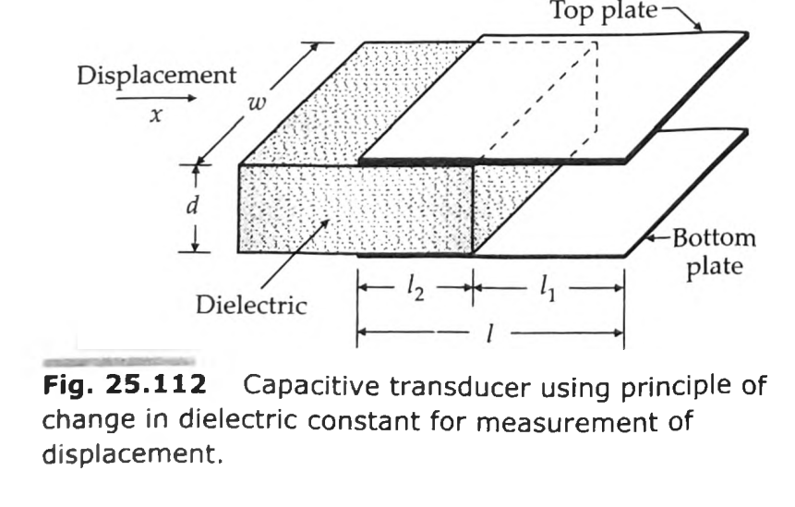
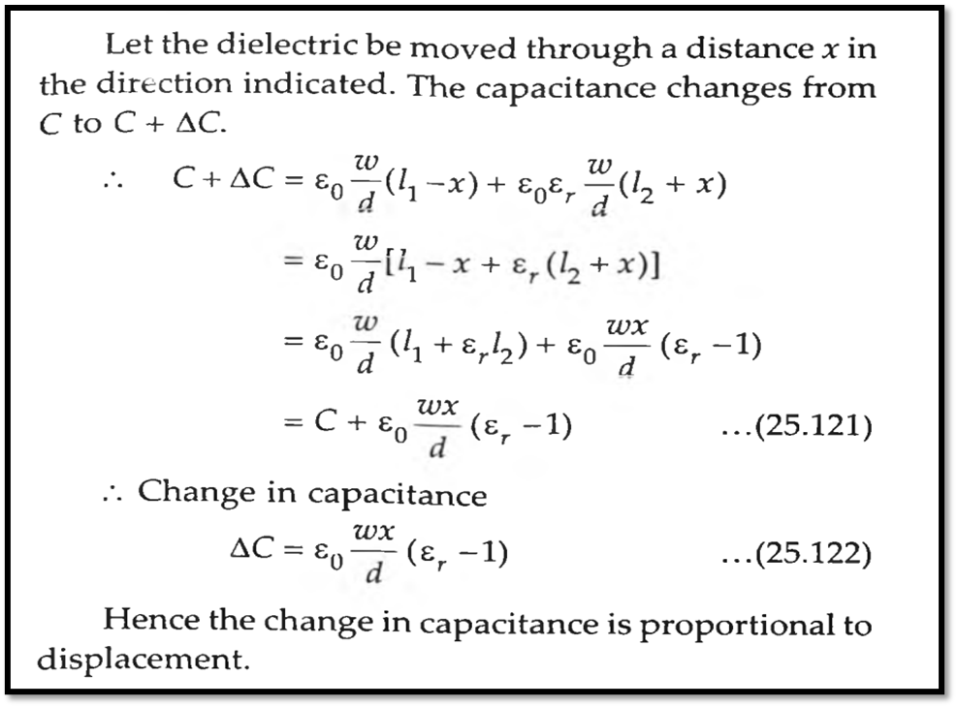
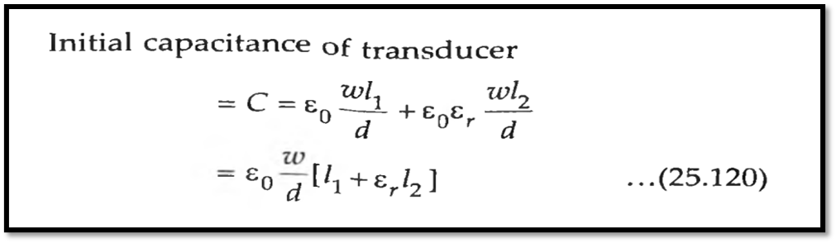
3. Variation of Dielectric Constant for Measurement of Displacement
A capacitive transducer for measurement of linear displacement working on the above mentioned principle. It has a dielectric of relative permittivity .

Slide 14
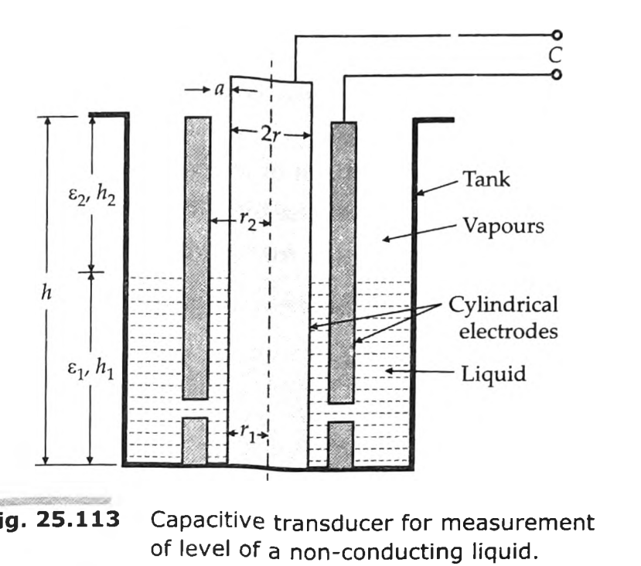
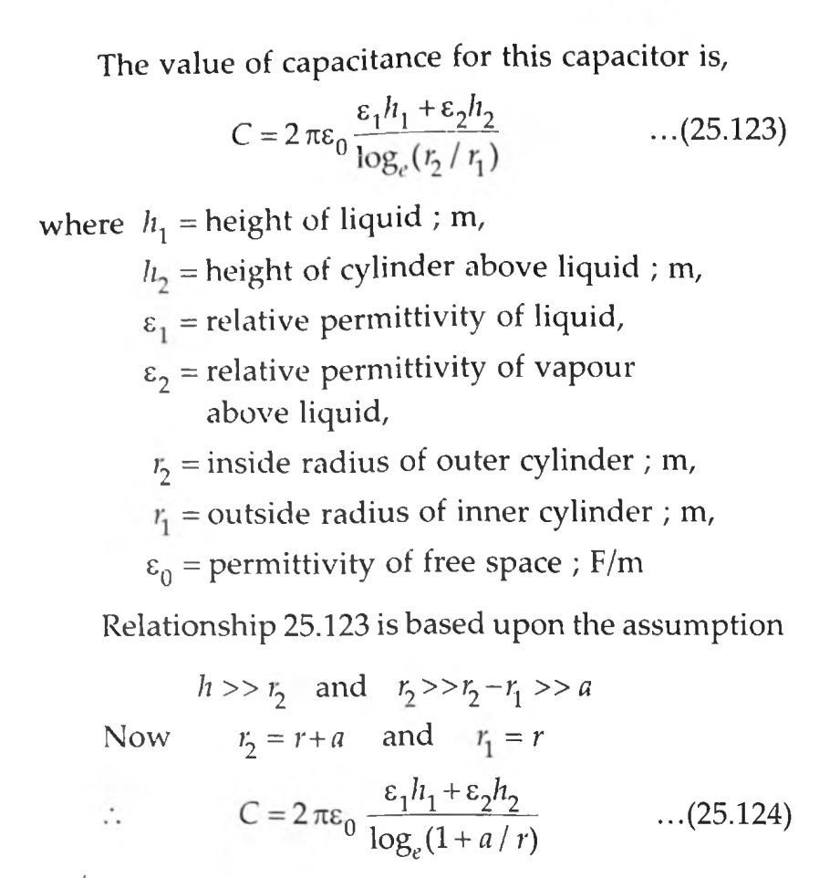
Variation of Dielectric Constant for Measurement of Liquid Level
The electrodes are two concentric cylinders and the non-conducting liquid acts as the dielectric. At the lower end of the outer cylinder there are holes which allow passage of liquid.
Capacitive transducers using the principle of change of capacitance with change of dielectric are normally used for measurement of liquid levels.

Slide 15
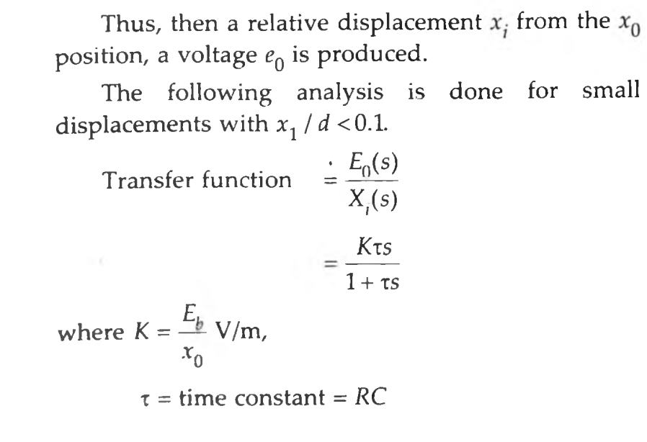
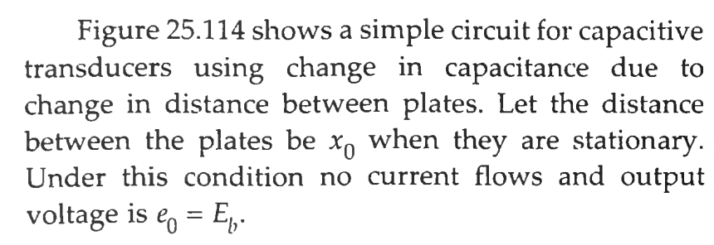
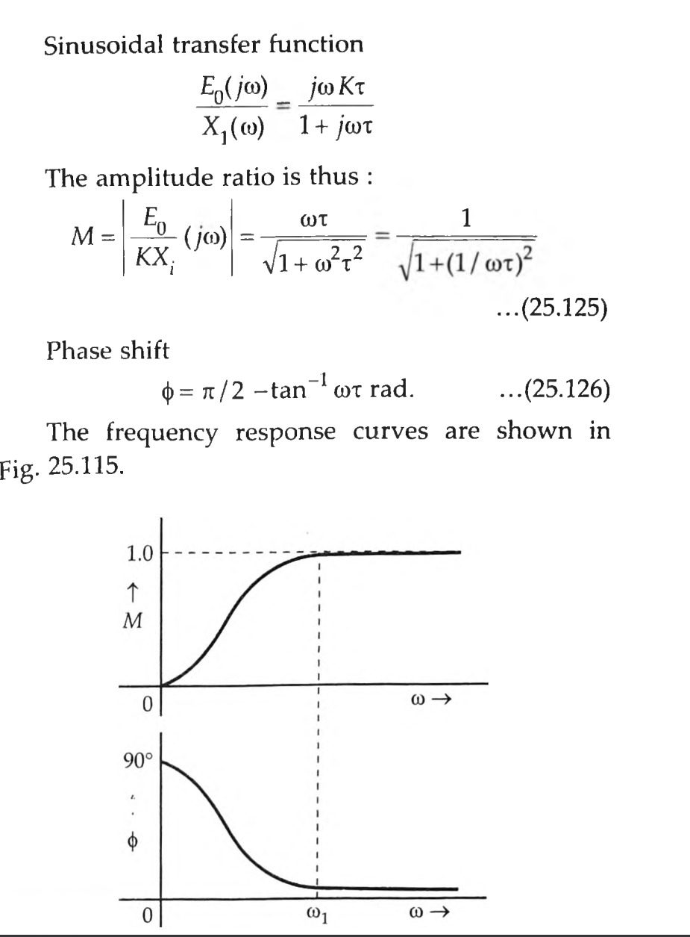
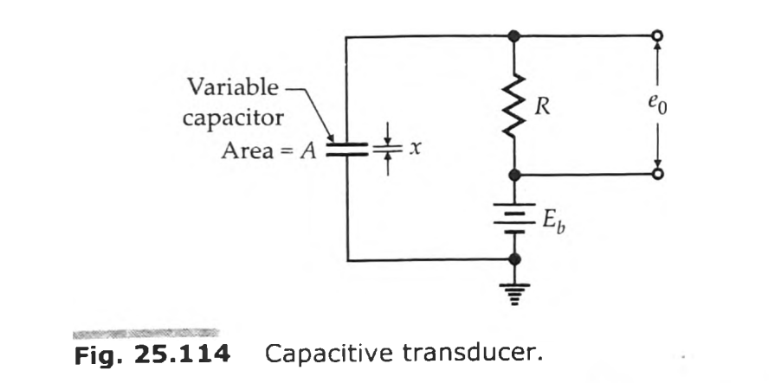
Frequency Response of Capacitive Transducers

Slide 16
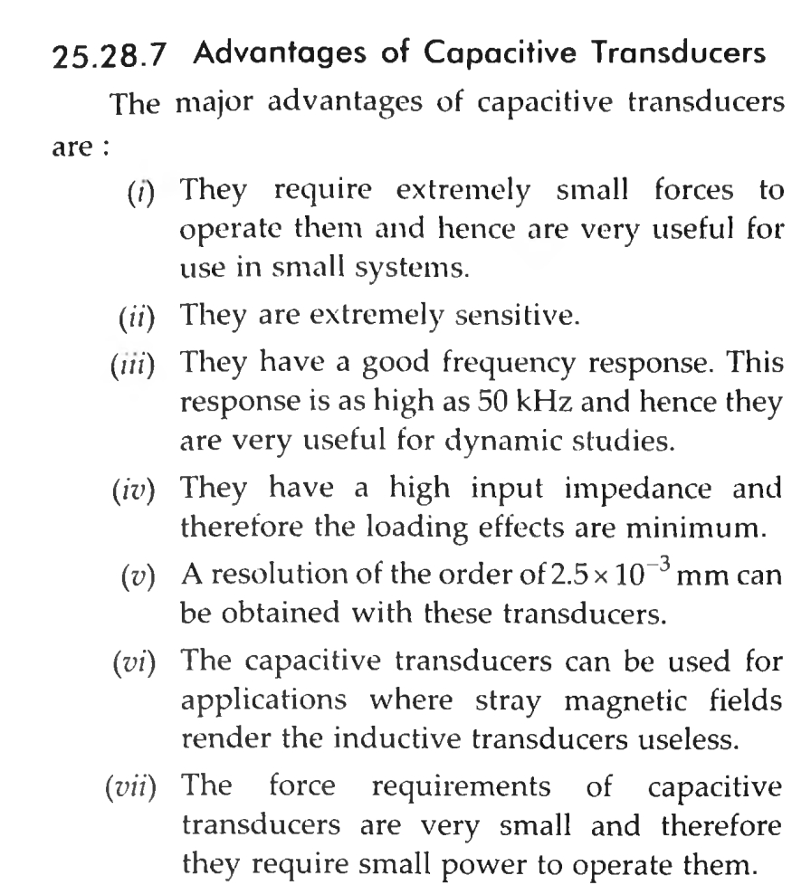

Slide 17
Disadvantages of Capacitive Transducers
The principal disadvantages of capacitive transducers are :
(I) The metallic parts of the capacitive transducers must be insulated from each other. In order to reduce the effects of stray capacitances, the frames must be earthed.
(II) The capacitive transducers show non-linear behaviour many a times on account of edge effects. Therefore guard rings must be used to eliminate this effect.
(III) The output impedance of capacitive transducers tends to be high on account to their small capacitance value. This leads to loading effects.
(iv) The cable connecting the transducer to the measuring point is also a source of error. The cable may be source of loading resulting loss of sensitivity. Also loading makes the low frequency response poor

Slide 18
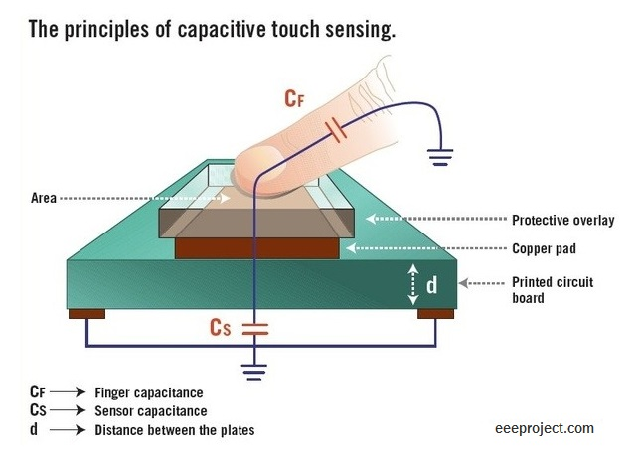
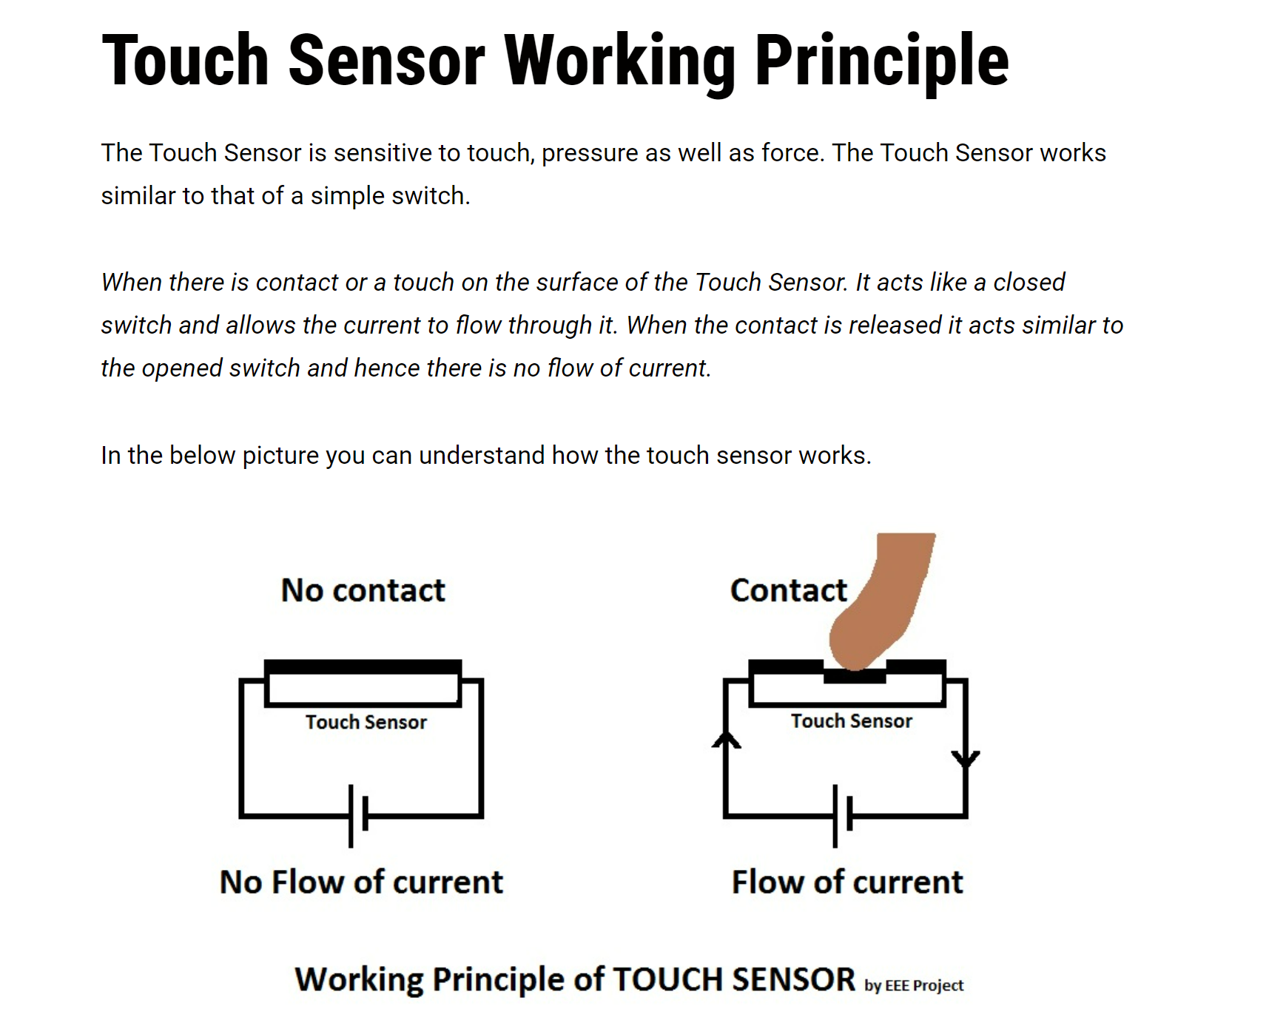
CAPACITIVE TOUCH SENSORS
Touch Sensors are the electronic sensors that can detect touch. They operate as a switch when touched. These sensors are used in lamps, touch screens of the mobile, etc.
Touch sensors are also known as Tactile sensors.

Slide 19
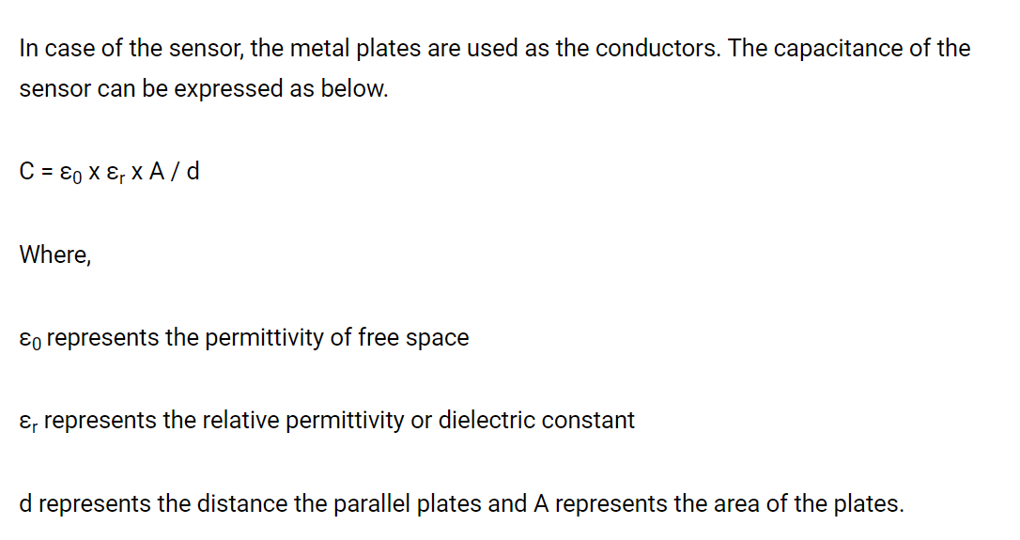
We know that if the plate has more area the more capacitance it will produce and the more distance between the two plates are the less capacitance will become.
In the Capacitive touch sensor, there are two parallel plates that form a capacitor with the capacitance value represented as C0. As we touch the sensor through our finger, our finger acts as a conductive object and hence produces a capacitance value of CT as shown in the figure below.
In the application of a sensor, the capacitance C0 is measured continuously with the help of the capacitance measurement circuit. There will be an uncertain increase in the capacitance if any conductive object such as our finger touches the plate. The capacitance measuring circuit will detect the change in the capacitance and will convert it into a signal.

Slide 20
